Slide 1
Solvency II: Principi e modelli per il calcolo del rischio nell’assicurazione vita
Roma, 17 Dicembre 2012

Slide 2
AGENDA
Solvency II Framework
An Introduction to Solvency II
Solvency 2 Definitions: Available Capital and Capital Requirement
Best Estimate of Liabilities: calculation process and examples
Required Capital: calculation process and examples
Applying Solvency II models: Risk Drivers and Practical Examples
New Products and Capital Absorption: definitions and examples

Slide 3
AGENDA
Solvency II Framework
An Introduction to Solvency II
Solvency 2 Definitions: Available Capital and Capital Requirement
Best Estimate of Liabilities: calculations process and examples
Required Capital: calculations process and examples
Applying Solvency II models: Risk Drivers and Practical Examples
New Products and Capital Absorption: definitions and examples

Slide 4
An Introduction to Solvency 2
Where are we?
We are defining rules to ensure the financial stability of an insurance and reinsurance company
  adequacy of technical provisions to meet insurance obligations towards the policyholders;
  availability of eligible and sufficient assets to cover the technical provisions;
  respect of a minimum capital adequacy requirement (SCR)
Calculation of the SH capital invested in the company (available capital)
Calculation of the capital requirement
Verify that Available Capital > Capital Requirement
Notes:
4

Slide 5
An Introduction to Solvency 2
Where are we?
Current EU rule: “Solvency 1”
Available Capital = Net Asset Value (local GAAP) + adjustments for assets eligibility
Capital Requirement =
4% x Reserves = “measuring the financial risks”
0.3% x Sum at Risk = “measuring the demographic risks”
Next Future: “Solvency 2”
Available Capital = Net Asset Value (based on the market evaluation of assets and liabilities)
Capital Requirement (SCR) = The capital requirement is based on the market evaluation of assets and liabilities, considering the effective risks which the undertakings are exposed to
Notes:
5

Slide 6
An Introduction to Solvency 2
Solvency II Directive
Solvency II is based on a three pillars approach:
«CALCULATIONS & NUMBERS»
Fomal Requirement to enhance the real «Risk Management»
Reporting
Consistency between pillars and system
Notes:
6
6

Slide 7
An Introduction to Solvency 2
  Solvency II timeline
Solvency II adoption
Local regulation towards Solvency II i.e.
Reg. 20 ISVAP, MaRisk Germany,…
Nov 2009:
Stress Tests EIOPA
Jan 2010 EIOPA proposes Level 2 Directive
Draft of Level 2 Directive
Dec 2011 Level 3 (EIOPA)
Dec
2009
Dec 2010
Dec
2011
31st Dec 2012*
22 Apr 2009:
Solvency II Directive approved
17 Dec 2009:
Solvency II Directive published (Level 1)
QIS5
Oct 2011: Level 2 Directive approved
(European Commission)
OMNIBUS 2
31 Jul 10: deadline for ISVAP for Internal Model
Potential delay
2015?
(*) The European Commission is considering the proposal of postponing the date of entry into force of the Directive from 31 October 2012 to 31 December 2012.
Notes:
7
7

Slide 8
AGENDA
Solvency II Framework
An Introduction to Solvency II
Solvency 2 Definitions: Available Capital and Capital Requirement
Best Estimate of Liabilities: calculation process and examples
Required Capital: calculation process and examples
Applying Solvency II models: Risk Drivers and Practical Examples
New Products and Capital Absorption: definitions and examples

Slide 9
Methodology: Available Capital
Solvency 2 Definitions: Available Capital and Capital Requirement
Available Capital under Economic Balance Sheet | Available Capital is the difference between the fair value of assets and the fair value of all liabilities Fair Value of Insurance Liabilities is estimated by projecting and discounting all future cash flows on a market consistent basis. It has two components: the Best Estimate Liability (BEL) and the Risk Margin. BEL is based on market values where they exist, and on estimates of market values where they do not exist (mark to model approach) Risk Margin reflects the margin required over BEL for situations where market prices cannot be observed, and is calculated using a cost of capital approach. Fair Value of Liabilities also includes the deferred tax liability from tax on profits that are expected to emerge on the difference between fair values and fiscal values of assets and liabilities.
Market value of assets
Available
Capital
Available
Capital
Risk Margin
Best
Estimate
of
Liabilities
Fair Value
of
Liabilities
Notes:
X3

Slide 10
Solvency 2 Definitions: Available Capital and Capital Requirement
Methodology: Risk Capital
Risk Capital under Economic Balance Sheet | Risk Capital (SCR) is the capital necessary to absorb the maximum loss of Available Capital, identified according to a 1-year value at risk approach, at a specified confidence level consistent with the risk appetite: at 99.5% (BBB) for Solvency II purposes.
Total Balance Sheet Approach
Distribution of Available Capital
Probability
Market value of assets
Available
Capital
AVAILABLE CAPITAL
Worst Case
Value
Risk Capital
Expected
Value
Value
Risk Margin
Risk Capital is equal to the difference between Available Capital (expected value) and Available Capital (worst case value) after the “worst-case scenario” (1-year value at risk approach, at a confidence level consistent with the risk appetite)
The mentioned “worst-case scenario” is referring to the joint occurrence of negative outcomes of the different risks
Best
Estimate
of
Liabilities
FAIR VALUE OF LIABILITIES

Slide 11
AGENDA
Solvency II Framework
An Introduction to Solvency II
Solvency 2 Definitions: Available Capital and Capital Requirement
Best Estimate of Liabilities: calculations process and examples
Required Capital: calculations process and examples
Applying Solvency II models: Risk Drivers and Practical Examples
New Products and Capital Absorption: definitions and examples

Slide 12
Methodology: Available Capital
Best Estimate of Liabilities: calculations process and examples
Available Capital under Economic Balance Sheet | Available Capital is the difference between the fair value of assets and the fair value of all liabilities Fair Value of Insurance Liabilities is estimated by projecting and discounting all future cash flows on a market consistent basis. It has two components: the Best Estimate Liability (BEL) and the Risk Margin. BEL is based on market values where they exist, and on estimates of market values where they do not exist (mark to model approach) Risk Margin reflects the margin required over BEL for situations where market prices cannot be observed, and is calculated using a cost of capital approach. Fair Value of Liabilities also includes the deferred tax liability from tax on profits that are expected to emerge on the difference between fair values and fiscal values of assets and liabilities.
Market value of assets
Available
Capital
Available
Capital
Risk Margin
Best
Estimate
of
Liabilities
Fair Value
of
Liabilities
Notes:
X3

Slide 13
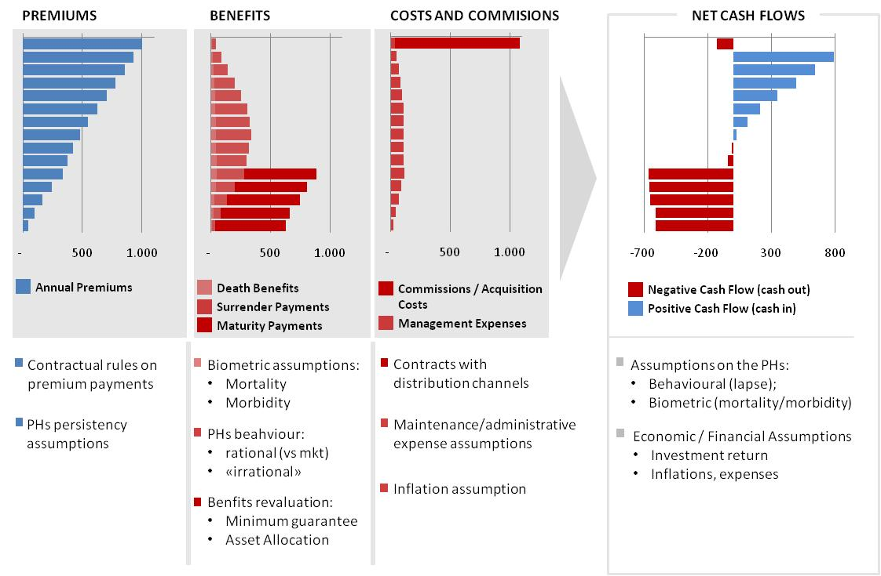
BEL = Present Value of Net Cash Flows
Best Estimate of Liabilities: calculations process and examples

Slide 14
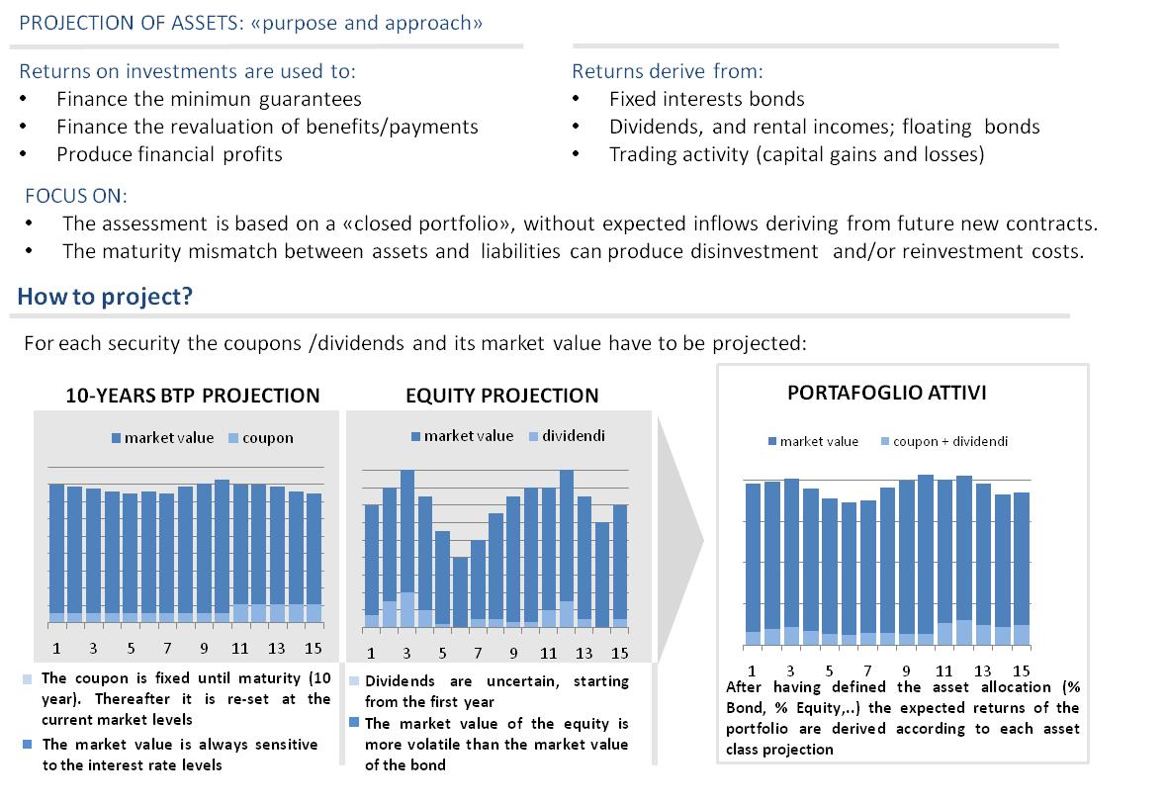
BEL: Assets Projection
Best Estimate of Liabilities: calculations process and examples

Slide 15
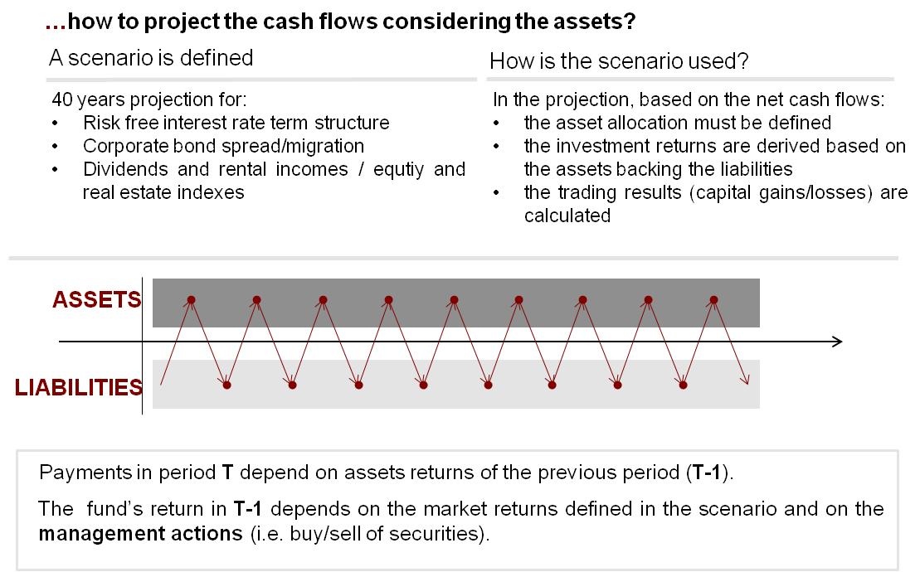
BEL: Asset and Liabilities Projection
Best Estimate of Liabilities: calculations process and examples

Slide 16

BEL: Methodological Aspects
Best Estimate of Liabilities: calculations process and examples
Future Cash Flows and Best Estimate Breakdown
  TP.1.213. Future cash-flows also need to be split into guaranteed and discretionary benefits because, as stated in Article 108 of the Level 1 text, the loss absorbing capacity of technical provisions is limited by the technical provisions relating to the future discretionary benefits. The risk mitigation effect provided by future discretionary benefits shall be no higher than the sum of technical provisions and deferred taxes relating to those future discretionary benefits.
BEL = Minimum guaranteed provisions + Future Discretionary benefits (FDB)
FDB = BEL - Minimum guaranteed provisions

Slide 17
BEL: Methodological Aspects
Best Estimate of Liabilities: calculations process and examples
How to calculate the minimum guarantee provisions
Deterministic valuation where the revaluation of the benefits is equal to the minimum guaranteed rate of return

Slide 18
Methodology: Understanding the FDB
Best Estimate of Liabilities: calculations process and examples
FDB = BEL - Minimum guaranteed provisions
Example:
Premium = 100
minimum guarantee for maturity benefits = 2%
profit sharing = 60%
Revaluation = max (2%, 60% x investment return)
Projected Return on Asset = 6%
Yearly revaluation
= max (2%; 60% x 6%) = 3.6%
Maturity Payment
= 100 x (1+ 3.6%)^3 = 111
Minimum Gurantee Benefit
= 100 x (1 + 2%)^3 = 106
FDB = 111 – 106 = 5
FDB
Avg yearly accrual 3.6%
FDB
Minimum
Guarantee
Min Gar 2%
Minimum
Guarantee
Best Estimate of Liabilities
T+1
Expense
T+2
Expense
T+3
Expense + Maturity Benefit

Slide 19
BEL: Methodological Aspects
Best Estimate of Liabilities: calculations process and examples
Is the “best estimate” a “good enough” estimate?
  2.2.3.1 Definition of “best estimate” and allowance for uncertainty
  TP.1.59. The best estimate shall correspond to the probability weighted average of future cash-flows taking account of the time value of money, using the relevant risk-free interest rate term structure.
  TP.1.67. Valuation techniques considered to be appropriate actuarial and statistical methodologies to calculate the best estimate as required by Article 86(a) include: simulation, deterministic and analytical techniques (based on the distribution of future of cash-flows) or a combination thereof.
  Present value of net cash-flows taking into consideration embedded options, if exist

Slide 20
BEL: Methodological Aspects
Best Estimate of Liabilities: calculations process and examples
How the Embedded Options affects the BEL?
Maturity Benefit before revaluation = 100
Expected Return: 3 possible scenarios 0% - 5% - 10%
Deterministic (Traditional) Approach:
Valuation in the Central Scenario:
return | Unit Linked w/o guarantee | Unit Linked 3% guarantee
5% | 100 x (1 + 5%) = 105 | 100 x (1 + 5%) = 105
Correct Approach:
Average of the valuation in all the scenarios
return | Unit Linked w/o guarantee | Unit Linked 3% guarantee
0% | 100 x (1 + 0%) = 100 | 100 x (1 + 3%) = 103
5% | 100 x (1 + 5%) = 105 | 100 x (1 + 5%) = 105
10% | 100 x (1 + 10%) = 110 | 100 x (1 + 10%) = 110
avg | (100+105+110) / 3 = 105 | (103+105+110) / 3 = 106
For Unit Linked w/o guarantee: BEL (centrale) = average BEL (in all the scenarios)
For Unit Linked with guarantee: BEL (centrale) < average BEL (in all the scenarios)
106 – 105 = 1 is the cost of the guarantee

Slide 21
BEL: Methodological Aspects
Best Estimate of Liabilities: calculations process and examples
CONTRACT W/O GUARANTEE
YEARLY GUARANTEE «OUT OF THE MONEY»
Central (no gar) = AVG_{1000scen}
Central < AVG_{1000scen}
Asymmetries:
CE < AVG_{1000scen}
For product without guarantee CE = AVG_{1000scen}
No need for stochastic scenarios.
The guarantee is out of the money:
CE = CE(no gar)
Cost of the Guarantee = CE - AVG_{1000scen}
C.E. curve
Stochastic scenarios
Min Gar

Slide 22
BEL: Methodological Aspects
Best Estimate of Liabilities: calculations process and examples
YEARLY GUARANTEE «IN THE MONEY»
AT MATURITY GUARANTEE
Central < AVG_{1000scen}
Central < AVG_{1000scen}
«in the money»
CE > CE(no gar)
Asymmetries:
CE < AVG_{1000scen}
Asymmetries:
CE < AVG_{1000scen}
The guarantee is «in the money»:
CE < CE(no gar)
Cost of the Guarantee :
Intrinsic Value = CE – CE(no gar) +
Time Value = AVG_{1000scen} – CE
The guarantee is out of the money:
CE = CE(no gar)
Cost of the Guarantee = CE - AVG_{1000scen}
C.E. curve
Reserves in the C.E. curve
Stochastic scenarios
Reserves in the stochastic scenarios
Min Gar
Reserves at the minimum guarantee

Slide 23
BEL: Methodological Aspects
Best Estimate of Liabilities: calculations process and examples
BEL Calculation: different approaches for different liabilities
Contracts w/o profit sharing and guarantees
  1. Deterministic approach: for business where cash flows do not depend on, or move linearly with market movements (i.e. business not characterised by asymmetries in shareholder’s results), the calculation can be performed using the certainty equivalent approach.
    Definition of a central scenario to project assets and liabilities and to discount the cash flows
Contracts with “simple” financial options
  2. Analytic Approach: In case of business where the cash flows generated by the financial options can be easily separated from the underlying liability (e.g. some unit-linked products), closed form solutions may be appropriate.
    Deterministic valuation of the product ignoring the financial options
    Closed form solutions to determine the value of the financial options (e.g. Black-Scholes formula)
    It does not allow for any policyholder or management actions.

Slide 24
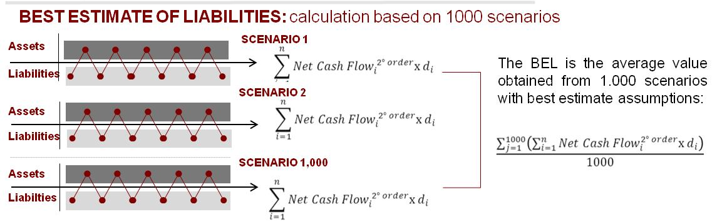
BEL: Methodological Aspects
Best Estimate of Liabilities: calculations process and examples
Contracts with guarantee and profit sharing
3.Stochastic simulation approach : for business where cash-flows contain options and financial guarantees, characterised by asymmetric relationship between assets and liabilities, e.g. traditional participating business
  Availability of Actuarial Tool to project future cash flows of assets and liabilities (ALM view), which is able to run a full set of economic scenarios, tacking into consideration management rules and policyholder behaviour
  Availability of Application Tool to generate stochastic scenarios for projections of asset prices and returns

Slide 25
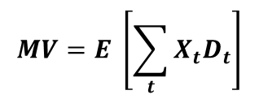

Market Consistent Valuation
Best Estimate of Liabilities: calculations process and examples
A valuation algorithm is a method for converting projected cash flows into a present value. A valuation is market consistent if it replicates the market prices of the assets.
The natural method of valuing such assets (or liabilities) would be to calculate the expected value of present value of future cash flows
future cash flows at time t
discount factor
The calculation of expected value requires a
probability distribution
There are two ways of valuing cash flows which must produce equivalent values under the modern financial economic theory:
  discount cash flows at the reference risk rate using risk-neutral probabilities
  consider real world probabilities discounting cash flows with the use of risk-adjusted rate (deflator)

Slide 26
Market Consistent Valuation
Best Estimate of Liabilities: calculations process and examples
Arbitrage-free pricing is the foundation for the basis of financial theory and pricing
If two assets yield the same set of future cash flows, they must have the same price in the market otherwise a risk-free profit (arbitrage opportunity) could be made by taking appropriate positions in the underlying assets
What is the forward price agreed today of an equity in 1 year having:
S = Equity price = 100
g = Expected equity yield = 7%
r = Risk-free growth rate = 3%
S*(1+g)/(1+r) = 100*1.07/1.03 = 103.88
S*(1+r) = 100*1.03= 103
Arbitrage opportunity
Arbitrage free

Slide 27

Market Consistent Valuation – Risk Neutral
Best Estimate of Liabilities: calculations process and examples
One of the major consequences of the Black and Scholes result is that the value of an option does not depend on the risk preferences of the investor
From the other side, as the risk preferences of investors do not affect the value of the option, any equity risk premium is irrelevant
In the risk neutral valuation
the expected excess return over the risk reference rate is zero for all the assets
interest rate used to discount future cash flows is the reference risk rate
As consequence, the probability are calibrated to the market

Slide 28


Market Consistent Valuation – Real World
Best Estimate of Liabilities: calculations process and examples
In the real world investors are not risk neutral and risk premiums are a fact of life in investment decisions which themselves affect the performance of assets.
Moving from a risk-neutral to real world
The return of the assets changes, reflecting the risk premiums of investors for assets with different risk characteristics and this happen in tandem with the use of the real probability distribution of return
To produce a market consistent valuation, the reference rate can no longer be used and a risk-adjusted rate for each scenario (deflator) has to be derived

Slide 29
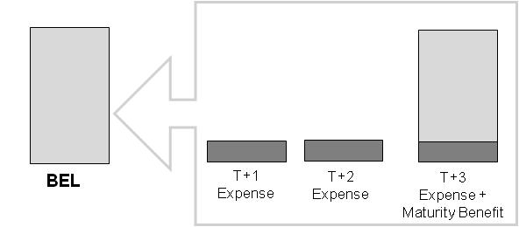
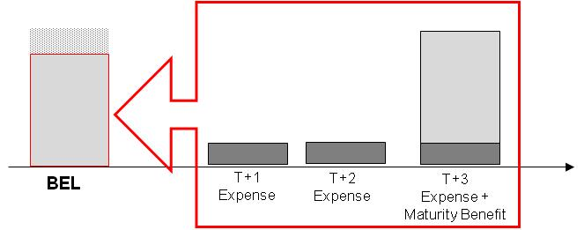
Market Consistent Valuation
Best Estimate of Liabilities: calculations process and examples
In the Risk Neutral Environment, setting the risk free rates has always 2 effects on the calculation of the Best Estimate of the Liabilities:
A: It defines the “discount factors”
Increasing the risk free rates, increase the discount factors, decrasing the BEL

Slide 30
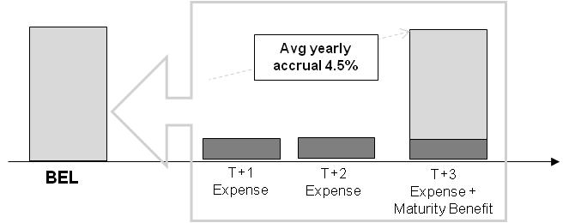
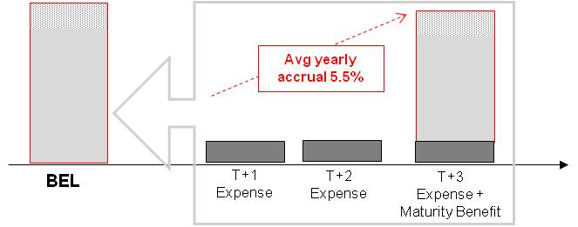
Market Consistent Valuation
Best Estimate of Liabilities: calculations process and examples
In the Risk Neutral Environment, setting the risk free rates has always 2 effects on the calculation of the Best Estimate of the Liabilities:
B: It defines the average expected return on the assets
Increasing the risk free rates, increases the projected returns, increasing the BEL
Increasing the risk free rates, decreases the cost of the guarantee, decreasing the BEL

Slide 31
Why Economic Scenario Generators?
Best Estimate of Liabilities: calculations process and examples
The financial products sold by insurance companies often contain guarantees and options of numerous varieties, (i.e. maturity guarantee, multi-period guarantees)
At the time of policy initiation, the options embedded in insurance contracts were so far out-of-the-money, that the companies disregarded their value as it was considered negligible compared with the costs associated with the valuation.
In light of current economic events and new legislations, insurance companies have realised the importance of properly managing their options and guarantees and it is one of the most challenging problems faced by insurance companies today.

Slide 32

Economic Scenario Generators
Best Estimate of Liabilities: calculations process and examples
reflect the expected future evolution of the economy by the insurance company (reflect the real world, hence the name)
Real world
include risk premium
calibration of volatilities is usually based on analysis of historical data
reproduce market prices
Market consistent
calibration of volatilities is usually based on implied market data
risk neutral, i.e. they do not include risk premium
arbitrage free
Economic Scenario
Equity
Interest
Rate
Real
Yield
Real Estate
Credit

Slide 33
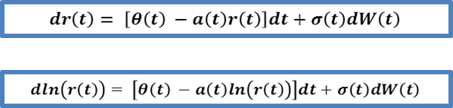
Economic Scenario Generators – Interest rate models
Best Estimate of Liabilities: calculations process and examples
The interest rate model is a central part of the ESG, as the price of most of the financial instruments are related to interest rates.
A large number of models have been developed in the few decades:
Short rate: based on instantaneous short rate
  Equilibrium or endogenous term structure
    term structure of interest rate in an output
  Vasicek (1977), Dothan (1978), Cox-Ingersoll-Ross (1985)
  No-arbitrage
    match the term structure of interest rate
    Hull-White (1990)
    Black-Karasinski (1991)
Forward rate: based on instantaneous forward rate
instantaneous forward Heath-Jarrow-Morton (1992)
LIBOR and swap market: describe the evolution of rates directly observable in the market
Instantaneous rate not observable in the market
Good pricing only for atm asset
Arbitrage free, are perfect for market consistent valuation
Easy to calibrate
Hard to calibrate
Good pricing for all assets

Slide 34
Economic Scenario Generators – Interest rate models
Best Estimate of Liabilities: calculations process and examples
Considering interest rate models where the market yield curve is a direct input, it is possible to derive an excellent-fitting model yield curve (the delta are really unimportant).

Slide 35
Economic Scenario Generators – Interest rate models
Best Estimate of Liabilities: calculations process and examples
The calibration of the volatility of the term structure is based on swaption prices, since these instruments gives the holder the right, but not the obligation, to enter an interest rate swap at a given future date, the maturity date of the swaption

Slide 36
Economic Scenario Generators – Credit model Calibration
Best Estimate of Liabilities: calculations process and examples
The most used Credit model is the Jarrow, Lando and Turnbull (1997) that is able to
  fit market credit spread for each rating class matching a single spread of a given rating and maturity
  provide a risk-neutral probability through annual transition matrix moving bonds to a different rating class (including default)

Slide 37
Economic Scenario Generators – Equity model Calibration
Best Estimate of Liabilities: calculations process and examples
Equity models are calibrated to equity implied volatilities, that are generally traded with terms up to two years; long terms are available over-the-counter (OTC) from investment bank. The choice depends on the users’ appetite for sophistication and liability profile
Constant volatility
(CV)
          is the Black-Scholes log-normal model implied volatilities of options will be quite invariant with respect to option term and strike.
Time varying deterministic volatility
(TVDV)
volatility vary by time according monotonic deterministic function
It captures the term structure of implied volatilities but are still invariant by strike
Stochastic volatility jump diffusion (SVJD)
captures the term structure and the volatility skew

Slide 38
Economic Scenario Generators – Reduce Sampling Error
Best Estimate of Liabilities: calculations process and examples
The Monte Carlo technique is subject to statistical error (“sampling error”); to reduce the magnitude of sampling error it is possible to
Run more simulation: the size of sampling error scales with the square root of the number of simulations. This mean that we would need to run 4 times the number of scenarios to halve the sampling error.
Variance reduction techniques: “adjust” the simulations, or the cash flows produced by them, or the weights assigned to them in a way that ensures the resulting valuations are still “valid” but the sampling error is reduced.
Martingale test is performed verifying that the discounted prices of the asset is the same as today’s price

Slide 39
Economic Scenario Generators – How Many simulations?
Best Estimate of Liabilities: calculations process and examples
Martingale test is so used to determine how many simulations are to be considered in the calibration of Economic Scenario.

Slide 40


Valuation Framework “the story so far”
Best Estimate of Liabilities: calculations process and examples
The “Market Consistency”
The Solvency 2 directive prescribes that:
The calculation of technical provisions should be consistent with the valuation of assets and other liabilities, market consistent and in line with international developments in accounting and supervision.
The CFO Forum in 2008 defines market consistent principles for the Embedded Vale Calculation

Slide 41

CFO Forum and MCEV Principles
Best Estimate of Liabilities: calculations process and examples
In May 2004, the CFO Forum published the European Embedded Value Principles and member companies agreed to adopt EEVP from 2006 (with reference to 2005 financial year)
EEV Principles consisted of 12 Principles and 65 related areas of Guidance
Other 127 comments, collected in the “Basis for Conclusions”, summarised the considerations in producing the Principles and Guidance
In October 2005, additional guidance on EEV disclosures was published to improve consistency of disclosures and sensitivities

Slide 42
CFO Forum and MCEV Principles
Best Estimate of Liabilities: calculations process and examples
European Embedded Value Principles
▪ Principle 1 | Introduction
▪ Principle 2 | Coverage
▪ Principle 3 | EV Definitions
▪ Principle 4 | Free Surplus
▪ Principle 5 | Required capital
▪ Principle 6 | Future shareholder cash flow from the in-force covered business
▪ Principle 7 | Financial options and guarantees
▪ Principle 8 | New Business and renewals
▪ Principle 9 | Assessment of appropriate projection assumptions
▪ Principle 10 | Economic assumptions
▪ Principle 11 | Participating business
▪ Principle 12 | Disclosure
Required use of appropriate approaches (e.g. stochastic simulations) to determine the impact of financial guarantees

Slide 43
CFO Forum and MCEV Principles
Best Estimate of Liabilities: calculations process and examples
CFO Forum – June 2008: launch of MCEV Principles
On the 4th June 2008, the CFO published the Market Consistent Embedded Value Principles
MCEV Principles:
replaced the EEV Principles (i.e. standalone document, no t supplement to EEV)
at beginning compulsory from year-end 2009 for CFO Forum members (early adoption was possible)
mandated independent external review of results as well as methodology and assumptions

Slide 44
CFO Forum and MCEV Principles
Best Estimate of Liabilities: calculations process and examples
Market Consistent Embedded Value Principles

Slide 45
CFO Forum and MCEV Principles
Best Estimate of Liabilities: calculations process and examples
Main implications of the MCEV Principles:
all projected cash flows should be valued in line with the price of similar cash flows that are traded in the capital markets [Principle 3 & 7]
use of swap rates as reference rates (i.e. proxy for risk-free rate) [Principle 14]
no adjustment for liquidity premium is allowed [Principle 14]
volatility assumptions should be based on implied volatilities derived from the market as at the valuation date (rather than based on historic volatilities) [Principle 15]
required capital should include amounts required to meet internal objectives (based on internal risk assessment or targeted credit rating) [Principle 5]
explicit and separate allowance for the cost of non hedgeable risks [Principle 9]
The launch of MCEV Principles was initially welcomed by analysts and investor community and it was seen as a step in the right direction

Slide 46
Financial market situation at YE2008: a “dislocated” market
Best Estimate of Liabilities: calculations process and examples
For Italy government bond rates higher than swap rates

Slide 47
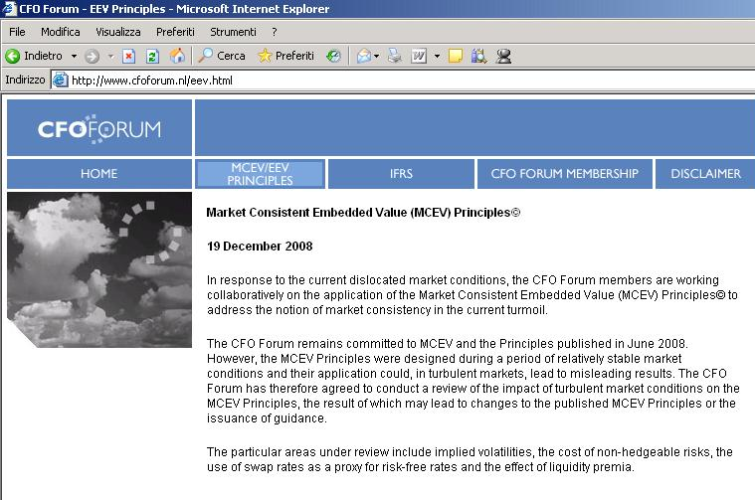
CFO Forum - December 2008: tackling extreme financial
Best Estimate of Liabilities: calculations process and examples
High volatility-> no “market” volatility
Swap rates < Govies -> Govies

Slide 48
CFO Forum - May 2009: deferral of mandatory date
Best Estimate of Liabilities: calculations process and examples
CFO Forum statement
further work needed
mandatory date of MCEV Principles reporting deferred from 2009 to 2011

Slide 49
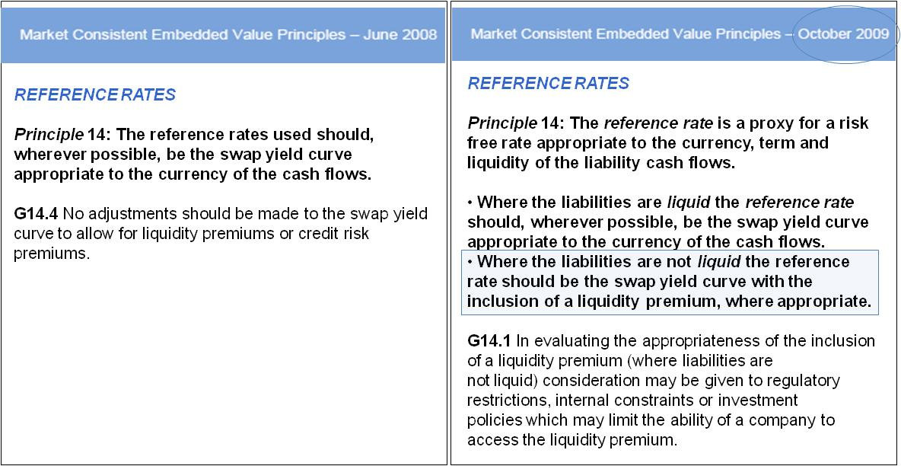
CFO Forum - October 2009: amendment of MCEV principles
Best Estimate of Liabilities: calculations process and examples
In October 2009, the CFO Forum announced a change to its MCEV Principles to reflect the inclusion of a liquidity premium
Corporate spread -> illiquidity premium

Slide 50
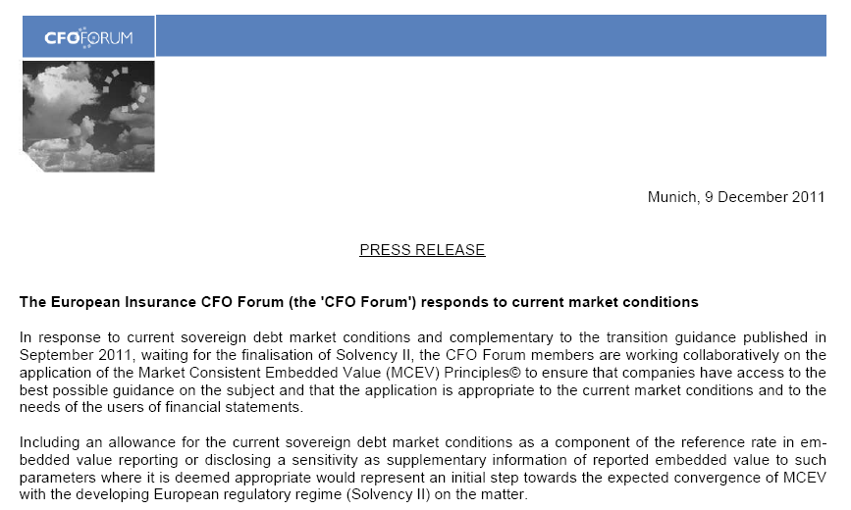
Latest developments – YE2011 Tackling the sovereign debt crisis
Best Estimate of Liabilities: calculations process and examples
Govies spread -> Additional adjustment over swap

Slide 51
Latest developments – Setting the Risk Free Rates
Best Estimate of Liabilities: calculations process and examples
The risk-free rate term structure is one of the most critical areas of Solvency2 framework, for the Fair Value of Liabilities and Available Capital.
The European Commission has defined in the QIS5 TS the risk free rate as
«SWAP – 10 bps + ILLIQUIDITY PREMIUM * %bucket»
BUT
The recent volatility in the financial market requests a «predictable counter-cyclical mechanism» to reduce the volatility without producing other undesirable effects.
Without a predictable counter-cyclical mechanism, insurers will be faced with uncertainty in managing risk which may lead to improper risk management (forced sale of assets and inappropriate ALM).
Lots of proposal are under discussion. The following are the most relevant open issues:
  the basic risk-free interest rate term structure (including credit spread)
  a counter-cyclical premium (only where market is dislocated)
  a matching adjustment (only for specific products)
  an extrapolation model (including UFR and convergence speed).
In the Trialogue should be agreed an exhaustive package for LTG. An Impact Assessment should be performed during next months

Slide 52
Counter Cyclical Premium: when and how
Best Estimate of Liabilities: calculations process and examples
The CCP should include
            an illiquidity premium (IP)
            a government spread premium (GSP)
Periods of distress will be independently identified by EITHER of these two triggers (Corporate bond spread OR Sovereign bond spread).
When the CCP triggers are activeted, the risk free rate can be:
Risk Free = SWAP – credit adjustment + α * IP + β * GSP
GSP = f (AAA&Other, swap, AA,default)

Slide 53
Counter Cyclical Premium: when and how
Best Estimate of Liabilities: calculations process and examples
There are three primary methods currently used by practitioners to estimate the illiquidity
premium in financial markets:
The method compares the spread on a corporate bond with the spread of a Credit Default Swap for the same issuing entity, same maturity, same seniority and same currency.
The method involves choosing a pair of assets which, besides illiquidity, are assumed to offer equivalent cash flows and equivalent credit risk. The primary example is an index of covered bonds versus swaps.
The method involves the use of option pricing techniques to calculate a theoretical credit spread which compensates only for credit (default and spread) risk. The difference between the theoretical spread and the actual market spread is typically taken to be illiquidity premium.
CDS Negative-basis method
Covered Bond method
Structural method

Slide 54
Derivation of the illiquidity premium
Best Estimate of Liabilities: calculations process and examples
By making use of estimates derived from a number of different methods together EIOPA
creates an overall estimate.
To do this a “proxy” method based on a simple transformation of the observed credit
spread is proposed:
The corporate bond spread is so considered to be comprised of three components:
an allowance for the cost of default
a risk premium to compensate bond
holders for bearing credit risk
an illiquidity premium to compensate
for the costs and associated
uncertainty of trading illiquid bonds

Slide 55
A practical example
Best Estimate of Liabilities: calculations process and examples
CCP = (Govies Adj. ; Illiquidity) = 178 bps

Slide 56
A simplified example (1/2)
Best Estimate of Liabilities: calculations process and examples
Illiquidity Premium: what impact if asset allocation is 100% Government Bond ?
The result depends on the rationale underlying spread widening
Illiquidity premium
Govies Spread
CCP – Govies Spread Adjustment: what impact if asset allocation is 100% Basket of Government Bond?
The result depends on the rationale underlying spread widening
BTP Spread Only
Basket Spread

Slide 57
A simplified example (2/2)
Best Estimate of Liabilities: calculations process and examples
CCP – Govies Spread Adjustment: what impact if asset allocation is 100% BTP ?
The result depends on the rationale underlying spread widening
BTP spread
Basket Spread
with 459 bps BTP
CCP – Govies Spread Adjustment: what impact if asset allocation is 100% BUND ?
The result depends on the rationale underlying spread widening
BTP spread
Basket Spread
with 459 bps BTP

Slide 58
Why a matching adjustment applied to a broader range of business?
Best Estimate of Liabilities: calculations process and examples
Solvency2 should capture the real risks for insurers: proposed SII regime makes insurance business more volatile than it really is.
The inclusion of a MA removes the inclusion of risk to which the insurer is not exposed
A Europe-wide application of a MA will promote stable long term investment and will support national governments and real economy through investment in sovereign bonds and long-term economic growth projects.
MA has been introduced in Omnibus II for a limited number of products only.
European Insurance industry asks the application of MA to a broader range of
insurance business since:
• Level playing field for all participants across Europe.
• Avoids making own funds appear more volatile than they actually are.
Insurers can demonstrate that they mitigate spread risks (typically investing in assets held to maturity) and are generally not exposed to forced sale of the corresponding assets. This substantially eliminates the exposure of insurers to market movements.
THE MATCHING ADJUSMENT PROPOSAL CAPTURES AND ARTICULATES IN
PRINCIPLES THE UNDERLYING ECONOMICS DESCRIBED ABOVE

Slide 59

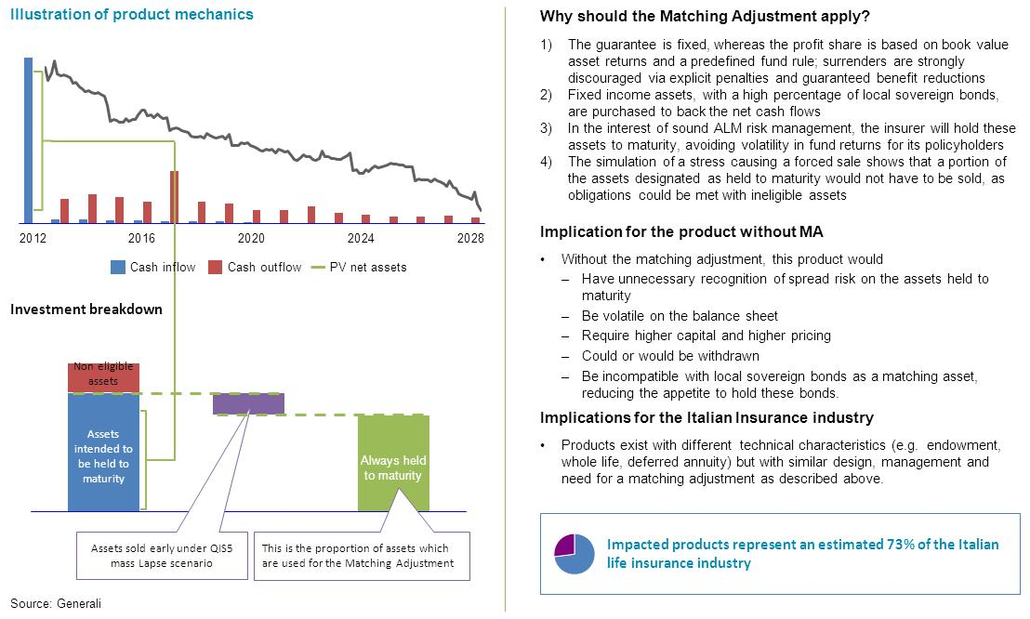
Example: Italian Product (profit sharing via Segregated Fund)
Best Estimate of Liabilities: calculations process and examples
Currently excluded because assets and liabilities are not fully matched and underwriting risks other than expense and longevity risk exist

Slide 60
Extrapolation: maturities of government bonds in EU markets
Best Estimate of Liabilities: calculations process and examples
Example maturities by market
Government bonds only
Country | % > 5 yrs | % > 10 yrs | % > 20 yrs | % > 30 yrs
Denmark | 10% | 0% | 0% | 0%
France | 98% | 89% | 68% | 29%
Germany | 25% | 2% | 0% | 0%
Italy | 68% | 49% | 20% | 1%
Norway | 32% | 0% | 0% | 0%
Spain | 68% | 22% | 6% | 0%
UK | 95% | 95% | 91% | 48%

Slide 61
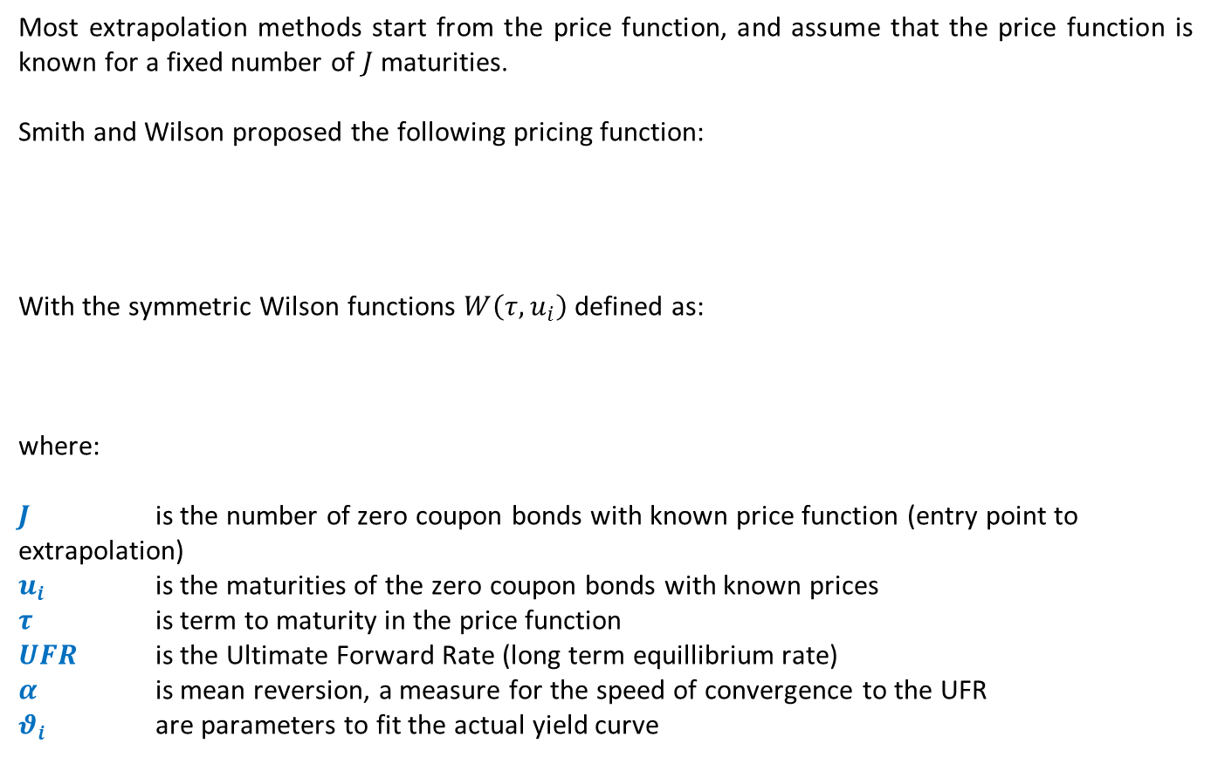
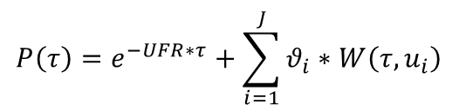
Extrapolation – Smith Wilson Approach
Best Estimate of Liabilities: calculations process and examples

Slide 62
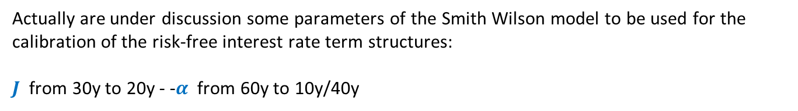
Extrapolation – From QIS5 to new industry proposal
Best Estimate of Liabilities: calculations process and examples

Slide 63
What does “best estimate operative assumptions” mean?
Best Estimate of Liabilities: calculations process and examples
Open issues
Mortality and longevity: selection factor or/and future trend?
Lapse: are the historical observations useful to infer the future?
Lapse: what type of link between market and surrenders?
Expense: is the S2 going concern?
Expense: what type of inflation?

Slide 64
Mortality assumptions – Lee Carter model
Best Estimate of Liabilities: calculations process and examples
Lee Carter approach to mortality forecast takes into account a stochastic projection model both to Best Estimate and Worst Case valuation
  Observed mortality rates are random variables representing past mortality
  Forecasted mortality rates are estimates of random variables representing future mortality
Sample: observed from mortality rates
Random paths of stochastic process
WC up
A model linking the probabilistic structure of the stochastic process to the sample
BE proj
WC down

Slide 65
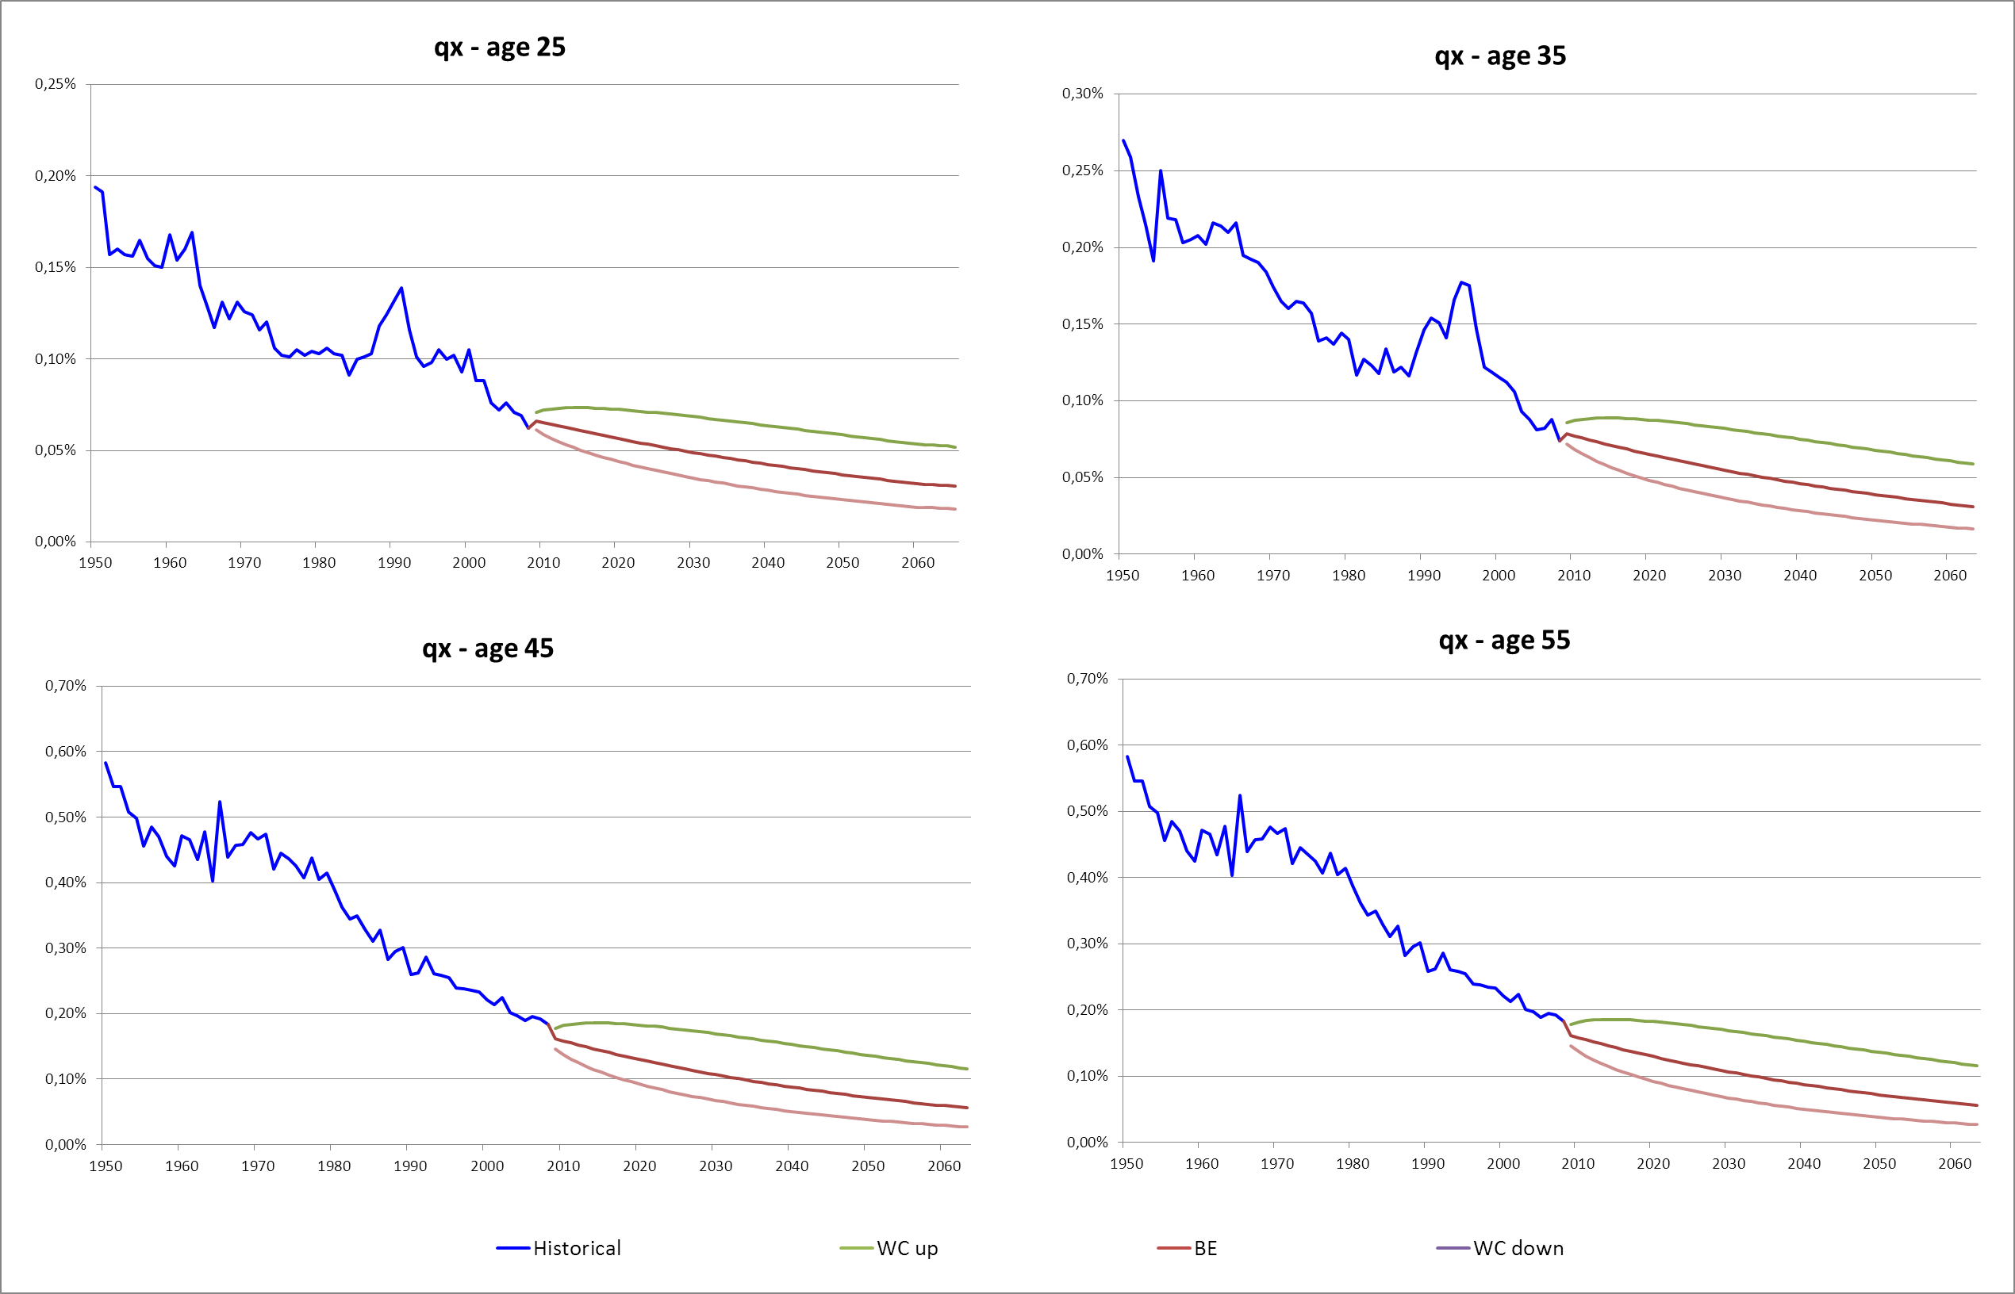
Mortality assumptions – Lee Carter model Example (Italy)
Best Estimate of Liabilities: calculations process and examples
Historical and projected mortality rates – q(x,t)

Slide 66
Mortality assumptions – Selection factor
Best Estimate of Liabilities: calculations process and examples
The mortality in the various underwriting classes and product groups can be expected to differ from projected mortality rates
Major selection factor causes:
Age and sex
Smoker status
Socioeconomic status
Method and quality of underwriting
Sales channel
Types of product

Slide 67
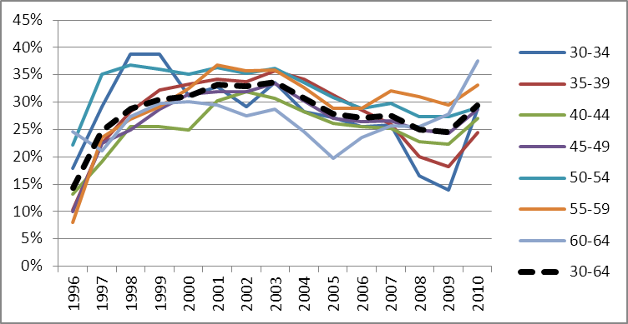
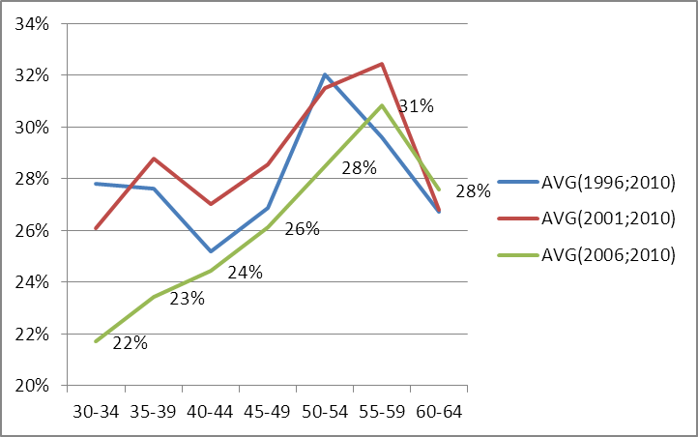
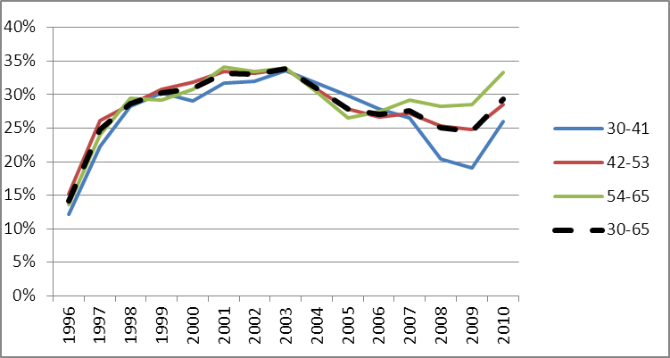
Mortality assumptions – Selection factor
Best Estimate of Liabilities: calculations process and examples
Application to real portfolio
Selection factors from 1996 to 2010 grouped in bukets of ages
Average selection factors for different age bukets considering different periods

Slide 68
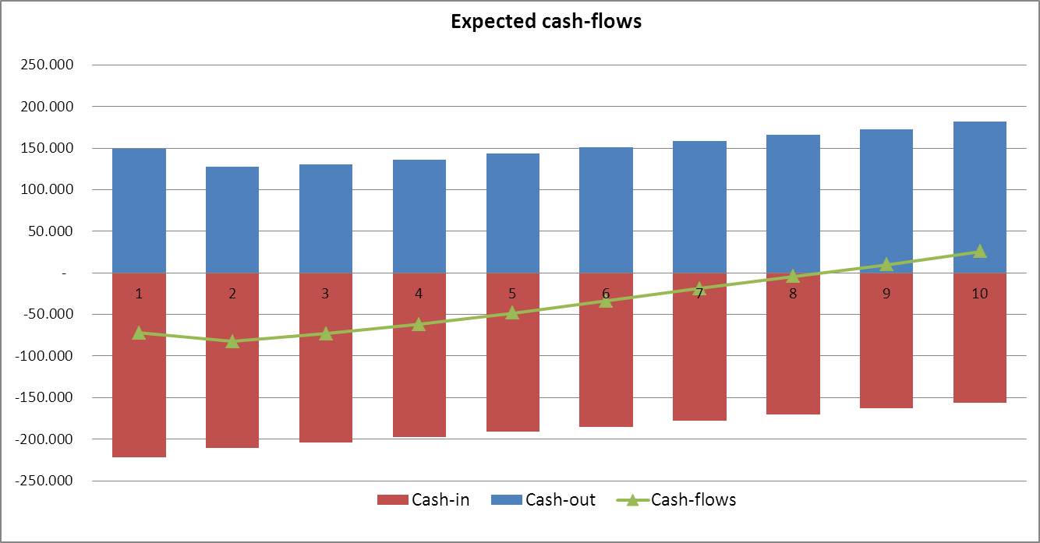
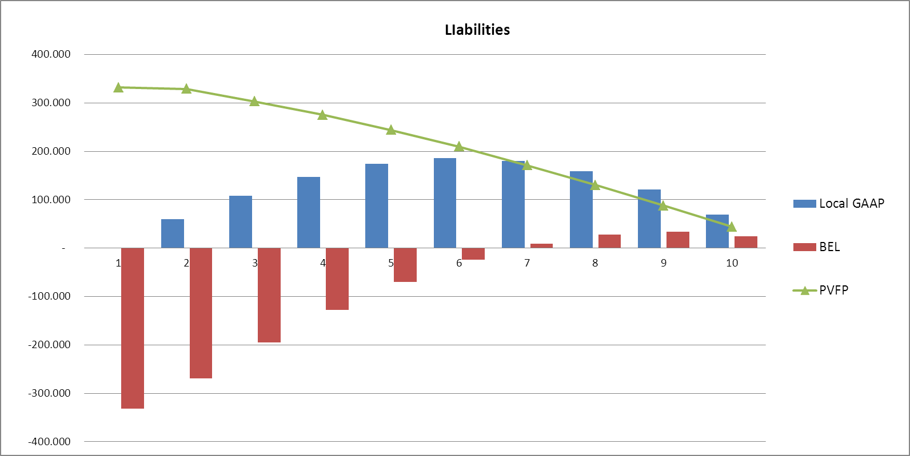
Mortality assumptions – Local GAAP vs. Best Estimate
Best Estimate of Liabilities: calculations process and examples
Term Life contract
Age | 40
Term | 10
I order mortality table | SIM 2003
II order mortality table | 80% SIM 2003
Technical interest | 3%
Premium loading | 10%
n. of contracts | 1,000
Premium | 213
Sum in case of death | 100,000

Slide 69
Impact of mortality improvement assumptions
Best Estimate of Liabilities: calculations process and examples
Annual Premium - Individual Term Life portfolio
(23,200 policies)
One Model Point of AP Individual Term Life portfolio
(7 policies – male – issue year 2007
duration 15 years I order mortality table SIM 1981)

Slide 70
AGENDA
Solvency II Framework
An Introduction to Solvency II
Solvency 2 Definitions: Available Capital and Capital Requirement
Best Estimate of Liabilities: calculations process and examples
Required Capital: calculations process and examples
Applying Solvency II models: Risk Drivers and Practical Examples
New Products and Capital Absorption: definitions and examples

Slide 71
Required Capital: calculations process and examples
Methodology: Risk Capital
Risk Capital under Economic Balance Sheet | Risk Capital is the capital necessary to absorb the maximum loss of Available Capital, identified according to a 1-year value at risk approach, at a specified confidence level consistent with the risk appetite: at 99.5% (BBB) for Solvency II purposes.
Total Balance Sheet Approach
Distribution of Available Capital
Probability
Market value of assets
Available
Capital
AVAILABLE CAPITAL
Worst Case
Value
Risk Capital
Expected
Value
Value
Risk Margin
Risk Capital is equal to the difference between Available Capital (expected value) and Available Capital (worst case value) after the “worst-case scenario” (1-year value at risk approach, at a confidence level consistent with the risk appetite)
The mentioned “worst-case scenario” is referring to the joint occurrence of negative outcomes of the different risks
Best
Estimate
of
Liabilities
FAIR VALUE OF LIABILITIES

Slide 72
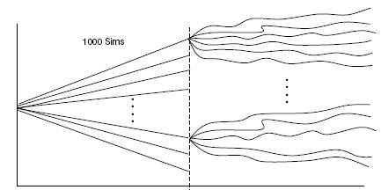
Methodology for Risk Capital: Theoretical approach
Required Capital: calculations process and examples
Realistic simulation of the
business over the first year
Market consistent revaluation
of liabilities at t=1
1.000 simulation for each realistic simulation:
10.000 x 1.000
Economic
Balance Sheet
at t=0
Available
Capital
0
1
Time
Solvency
Balance Sheet
at t=0
Available Capital
Probability
Joint distribution of all the risk factors
Discounting
to t=0 at
risk free rate
Worst Case
Value
Risk Capital
Expected
Value
0.50%
Value

Slide 73
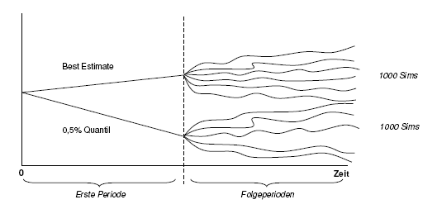
Required Capital: calculations process and examples
Methodology for Risk capital: Modular Approach (1/3)
alternative solution: Modular approach
Focus on the single risk factors:
for each of them the stress level corresponding to desired confidence level is determined
Identification of Risk Factors that affects the AC distribution
density f(x)
Expenses
Lapses
Longevity
Credit Risk
Operating Events
Mortality
f(x)
Markets
WC
BE
Risk Factor
Available
Capital
AC
AC
Best Estimate
Worst case
(risk factor i)
Best Estimate
Worst Case
risk factor i
0
1
Time
SCR = AC (BE) – AC(WCi)

Slide 74
Required Capital: calculations process and examples
Methodology for Risk capital: Modular Approach (2/3)
RISK FACTOR 1
RISK FACTOR 2
RISK DRIVER n
. . . . . . .
BE
WC
BE
WC
BE
WC
The stress impacts for all the risk drivers are finally aggregated using a correlation matrix in stress conditions

Slide 75
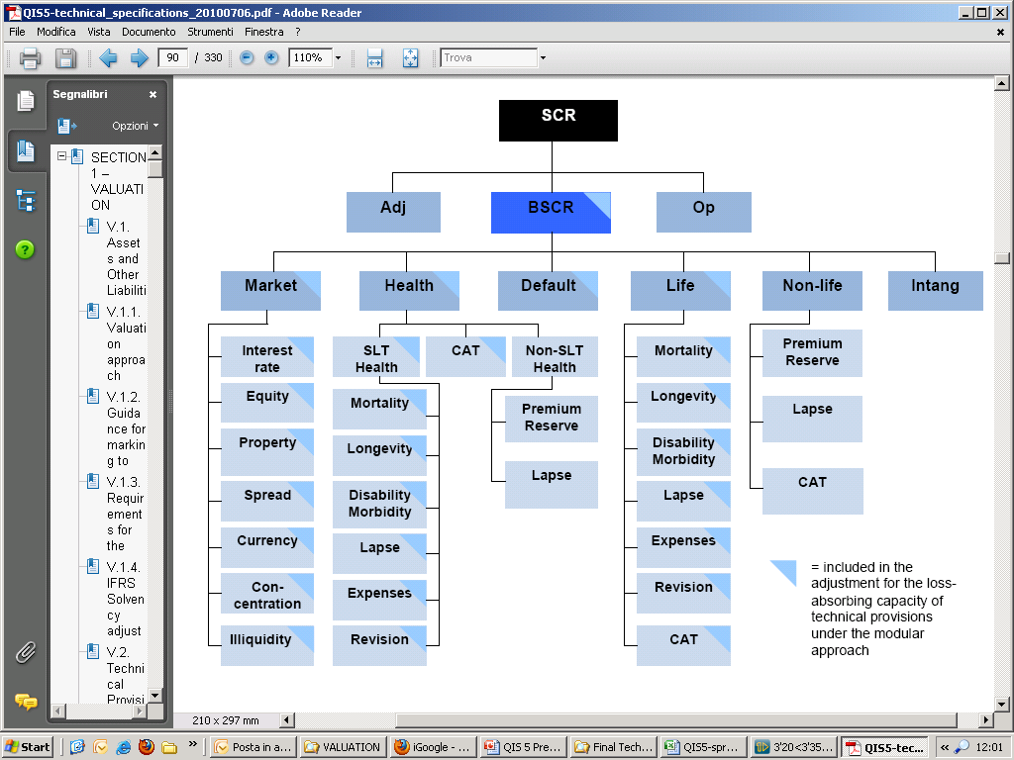
Required Capital: calculations process and examples
Methodology for Risk capital: Modular Approach (3/3)
Solvency II Framework: risk overview
Notes:
75

Slide 76

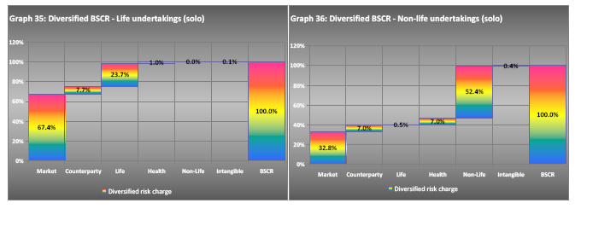
QIS5 – Final Results
Required Capital: calculations process and examples
Notes:
76

Slide 77
Required Capital: calculations process and examples
Methodology: Risk Capital
Is the Standard Formula the unique way to evaluate SCR for Solvency2 purpose?
→ Solvency II framework allows Companies to adopt an Internal Model or a Partial Internal Model.
BUT
Internal Model (IM) and Partial Internal Model (PIM) must be approved!
To obtain the approval, Companies are required to demonstrate that their IM / PIM verifies some Tests and Standards explicitly reported in the Solvency II Directive.

Slide 78
Required Capital: calculations process and examples
Methodology: Risk Capital
Use
Test
The Internal Model must be widely used in and plays an important role in the Company’s system of governance
Statistical
Quality
Standard
Data quality – Adequate, applicable and relevant actuarial and statistical tecniques – PDF based on current and credible information and realistic assumptions – Coverage of all material risks – Inclusion of mitigation tecniques and diversification effects
Calibration
Standard
The Internal Model must provide policyholder and beneficiaries with the same level of protection equivalent to the Standard Formula della formula standard (i.e. VaR 99,5%)
Profit and
Loss
Attribution
The Internal Model must identify the sources of profits and losses and must explain those sources in respect of categorisation of internal model risks and the Company’s risk profile
Validation
Standard
A regular model validation cycle must be put in place that includes monitoring the performance of the Internal Model, reviewing the on-going appropriateness of its specification and testing its results against experience
Documentation
Standard
Company must document the design and operational details of the Internal Model, guaranteeing compliance with Directive articles 120-124, with focus on theory, assumptions, mathematical and empirical basis and circumstances for not working
External Model
and Data
All the above mentioned requirements must be considered also regarding the use of external model and data obtained from a 3rd party

Slide 79
Required Capital: calculations process and examples
Other Risk Based Capital Models
Different approaches can be implemented to evaluate Risk based Capital
VaR or Tail VaR*: Solvency 2 vs Swiss Solvency Test
One year or multi-year?
Modular approach ?
Probability distribution forecast? Using which type of model?
Including or not loss absorbency capability of liability ?
Internal model or standard formula?
  *Value at Risk (VaR): massima perdita attesa, in uno specifico orizzonte temporale e ad un predefinito livello di confidenza.
  TailVaR: media delle perdite che eccedono, in uno specifico orizzonte temporale un predefinito livello di confidenza.
  Riassumendo, considerando 10.000 perdite simulate, il VaR sarà uguale alla 50-esima maggiore perdita mentre il TAilVAR sarà la media delle 50 perdite maggiori.
Notes:
79

Slide 80
Required Capital: calculations process and examples
Methodology for Risk capital: Underwriting Risk
Solvency II Framework: Underwriting Risk
Notes:
80

Slide 81
Required Capital: calculations process and examples
Underwriting Risk
Valuation Framework for Underwriting Risks
Available Capital: Pre Stress
Available Capital: Post Stress
Calculation of Market Value of the Assets and Fair Value of the Liabilities in the Central Scenario with Best Estimate Assumptions
Definition of the stressed underwriting stressed financial assumptions
Calculation of the Best Estiamate of the Liabilities in the stressed scenario
Calculation of the SCR as the difference between the Available capital in the central and in the stressed scenario
Available
Capital
Available
Capital
Stress
Asset
Liabilities
Asset
Liabilities
Risk Capital: ∆ Available Capital
Available
Capital
SCR
Available
Capital
Pre Stress
Post Stress

Slide 82
Required Capital: calculations process and examples
Underwriting Risk
LONGEVITY RISK – annuity contracts
Change of Mortality Assumptions
1. Before Stress
Fair Value of Liabilities
T+1
Annuity
T+2
Annuity
T+3
Annuity
T+4
Annuity
T+5
Annuity
2. After Stress
Mortality assumptions = qx (1- 25%)
Fair Value of Liabilities
T+1
Annuity
T+2
Annuity
T+3
Annuity
T+4
Annuity
T+5
Annuity
T+6
Annuity

Slide 83
Required Capital: calculations process and examples
Methodology for Risk capital: Market Risk
Solvency II Framework: Underwriting Risk
Notes:
83

Slide 84
Methodology for Risk capital: Market Risk
Required Capital: calculations process and examples
Valuation Framework for Market and Credit Risks
Available Capital: Pre Stress
Available Capital: Post Stress
Calculation of Market Value of the Assets and Fair Value of the Liabilities in the Central Scenario with Best Estimate Assumptions
Definition of the stressed financial stressed financial assumptions
Calculation of the Market value of the assets and the Best Estimate of the Liabilities in the stressed scenario
Calculation of the SCR as the difference between the Available capital in the central and in the stressed scenario
Available
Capital
Stress
Available
Capital
Asset
Liabilities
Asset
Liabilities
Risk Capital: ∆ Available Capital
Available
Capital
SCR
Available
Capital
Pre Stress
Post Stress

Slide 85
Methodology for Risk capital: Market Risk
Required Capital: calculations process and examples
Alternative definition of SCR: change in assets – change in liabilities
SCR = ∆ AC
SCR = ∆ MVA - ∆ FVL
The SCR formula can be rewritten as the difference between the change in market value of the assets and the change in market value of the liabilities (pre and post stress)
This is the main interpretation of the absorbency capacity and it is applicable for Equity, Credit, Property and Currency risks.
Available
Capital
SCR
∆ MVA
SCR
Available
Capital
∆ FVL
Pre Stress
Post Stress
Asset
Liabilities
LAC “basic” interpretation and LAC index
SCR
SCR may be lower than ∆MVA, as the loss on the assets can be partially “absorbed” by a reduction of the Liabilities
∆ MVA
∆ FVL
Asset
Liabilities
∆ Fair value of Liabilities
LAC index =
∆ Market value of Assets

Slide 86
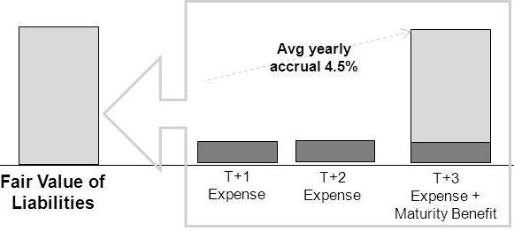
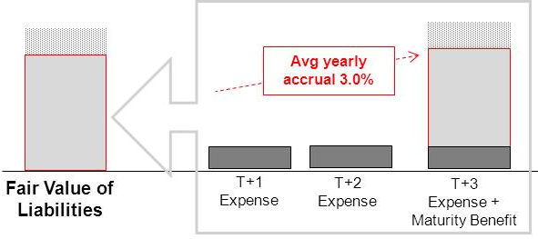
Methodology for Risk capital: Market Risk
Required Capital: calculations process and examples
Equity Risk: Immediate loss in market value of the assets
1.Unit Linked Contract
1. Before Stress
2. After Stress
SCR
The benefits are constantly linked to the return on the assets. The absorption is almost «complete».
LAC index = 90% - 95%
∆ MVA
∆ FVL
Asset
Liabilities

Slide 87
Methodology for Risk capital: Market Risk
Required Capital: calculations process and examples
Unit Linked Portfolio w/o Guarantee
150 EQUITY
50 AC
100 EQUITY
47 AC
950 FVL
903 FVL
850 BOND
850 BOND
MV Equity
- 33%= -50
Change in Market Value = 50
Change in Liabilities = 47
SCR = AC – AC^{equity} = 50 – 47 = 3
Liability absorption = change in liabilities / change in assets = 47/50 = 95%
In a unit linked contract the market risk is in charge of the insured;
the asset stress produced only a “proportional reduction” of the expected profits (total MVAssets = -8% -> AC -8%)

Slide 88
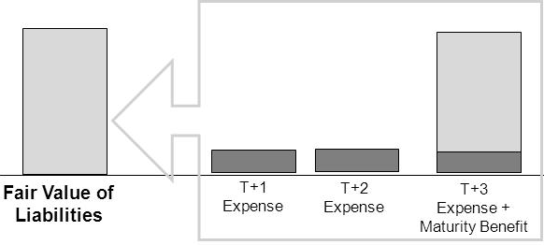
Methodology for Risk capital: Market Risk
Required Capital: calculations process and examples
Equity Risk: Immediate loss in market value of the assets
2.Contract Without Profit Sharing
1. Before Stress
2. After Stress
No liability absorption.
The SCR is equal to the loss in market value of the assets.
LAC index = 0%
∆ MVA
SCR
Asset
Liabilities

Slide 89
Methodology for Risk capital: Market Risk
Required Capital: calculations process and examples
Term Assurance
150 EQUITY
700 AC
100 EQUITY
650 AC
850 BOND
850 BOND
MV Equity
- 33%=-50
300 FVL
300 FVL
Change in Market Value = 50
Change in Liabilities= 0
SCR = AC – AC^{equity} = 50
Liability absorption = change in liabilities / change in assets = 0/50 = 0%
In a term the market risk is in charge of the insurer
the asset stress doesn’t affect the liabilities, therefore all the stress produces a PVFP reduction

Slide 90
Methodology for Risk capital: Market Risk
Required Capital: calculations process and examples
Equity Risk: Immediate loss in market value of the assets
3.Traditional Saving contract minimum guarantee and profit sharing
FDB
Avg yearly accrual 4.5%
FDB
Minimum
Guarantee
Minimum
Guarantee
Fair Value of Liabilities
T+1
Expense
T+2
Expense
T+3
Expense + Maturity Benefit
FDB
Avg yearly accrual 3.5%
FDB
Minimum
Guarantee
Minimum
Guarantee
Fair Value of Liabilities
T+1
Expense
T+2
Expense
T+3
Expense + Maturity Benefit

Slide 91
Methodology for Risk capital: Market Risk
Required Capital: calculations process and examples
Equity Risk: Immediate loss in market value of the assets
3.Traditional Saving contract minimum guarantee and profit sharing
Asset
Liabilities
∆ MVA
FDB
FDB
Minimum
Guarantee
Minimum
Guarantee
Pre stress
Post stress
Pre stress
Post stress
SCR
The benefits are linked to the return on the assets. The only absorbing liability is the FDB.
0% ≤ LAC index < 100%
∆ MVA
∆ FVL
Asset
Liabilities

Slide 92
Methodology for Risk capital: Market Risk
Required Capital: calculations process and examples
Case C: Product with guarantee and Profit Sharing (80%)
150
EQUITY
250
AC
100
EQUITY
240
AC
850
BOND
CORP
150 FDB
850
BOND
CORP
110 FDB
600
Minimum
Guarantee
MV Equity
- 33%=-50
600
Minimum
Guarantee
Change in Market value of Assets = 150*33% = 50
Change in FVL = 750 – 710 = 40
Change in AC = 250 – 240 = 10
Liability absorption = 10/ 40 = 80%
The loss is shared: 20% SH, 80% PH
In a product with profit sharing, both proifts and losses are shared; the % of sharing is a function of the portfolio structure and the level of the stress
In general we can notice an absence of linearity among the loss sharing partecipation and the increase of the stress level

Slide 93
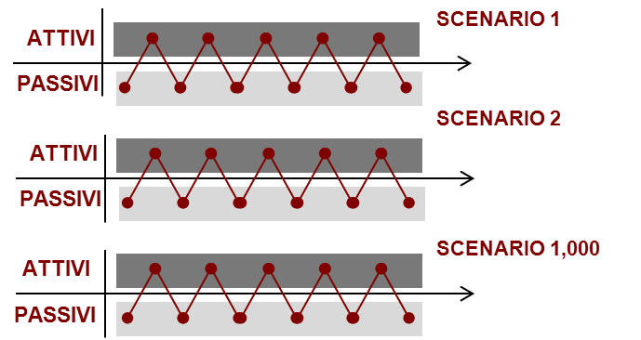
Methodology for Risk capital: Market Risk
Required Capital: calculations process and examples
Equity Risk - The calculation process requires :
1. the calculation of the market value of the assets and the fair value of the technical provisions at valuation date:
Asset Allocation
Market Value
Fair Value Technical Provisions:
750
Equity
Government Bonds: 450
Corporate Bonds: 400
Equities: 150
Government Bond
Corporate Bond
2. Calculation of the 99,5% stress on the asset side is calculated : i.e. the loss of 50 (150*33%).
3. re-valuation of the value of the technical provisions in the 1,000 scenarios where the initial assets have a lower value (-50).
The revaluation of benefits can be decreased according to the profit sharing rules.
Fair Value of
Tech.
Provisions:
710
4. The capital requirement is not equal to 50 euro (as in non life segment) but 10 euro (50-40), by ceding part of the loss (80%) to the policyholders, through the absorption provided by the profit sharing rules.
Equity risk capital charge:
Loss on assets:
50
Capital requirement before absorption:
50
Tech. Provision decrease:
-40
The liabilities absorption capability, depends on the expected returns and on the level of the guarantees.
10
Net capital requirement:

Slide 94
Loss Absorbency Capacity – Equity Risk
Required Capital: calculations process and examples
Equity Risk: the LAC asymmetry
LAC vs change in expected returns
Sources of LAC asymmetry:
1.
Profit
Sharing
Effect
2.
Increased Cost of the Guarantee
3.
Exhaustion of the FDB

Slide 95
Loss Absorbency Capacity – Equity Risk
Required Capital: calculations process and examples
Equity Risk: the LAC asymmetry
LAC vs change in expected returns
1.
Profit
Sharing
Effect
2.
Increased Cost of the Guarantee
3.
Exhaustion of the FDB

Slide 96
Loss Absorbency Capacity – Equity Risk
Required Capital: calculations process and examples
1. Profit Sharing «mitigating» effect
Before Stress
PH = max(gar, 80% x return)
Avg Return
PH Return
FDB
6.5%
Bonus = 2.7%
2.7%
Gar = 2.5%
2.5%
Minimum
Guarantee
Asset
Liabilities
After Stress
Avg Return
PH Return
∆ MVA
-1.5%
FDB
-1.2%
5.0%
Bonus = 1.5%
1.5%
Gar = 2.5%
2.5%
Minimum
Guarantee
Asset
-1.2%
Liabilities
LAC =
= 80% = Profit sharing
-1.5%

Slide 97
Loss Absorbency Capacity – Equity Risk
Risk Capital Calculation
Equity Risk: the LAC asymmetry
LAC vs change in expected returns
1.
Profit
Sharing
Effect
2.
Increased Cost of the Guarantee
3.
Exhaustion of the FDB

Slide 98
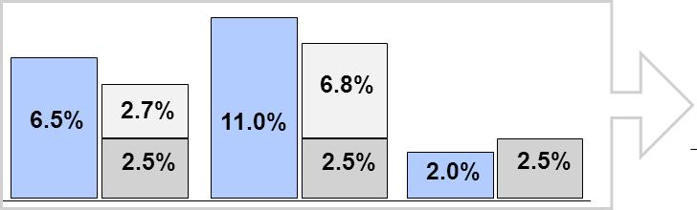
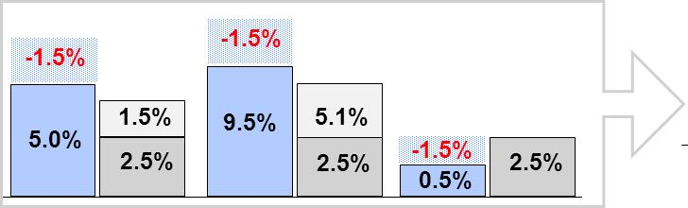
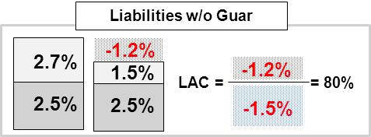
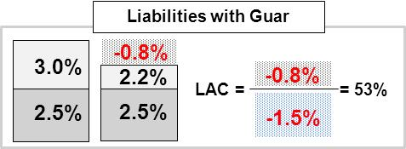
Loss Absorbency Capacity – Equity Risk
Required Capital: calculations process and examples
2. Increased cost of the Guarantee
Stochastic scenarios before stress
3.0%
2.7%
Cost of the guarantee
2.5%
2.5%
Liabilities
Liabilities
w/o Guar
Stochastic scenarios after stress
2.2%
1.5%
Cost of the guarantee
2.5%
2.5%
Liabilities
Liabilities
w/o Guar

Slide 99
Loss Absorbency Capacity – Equity Risk
Required Capital: calculations process and examples
Equity Risk: the LAC asymmetry
LAC vs change in expected returns
1.
Profit
Sharing
Effect
2.
Increased Cost of the Guarantee
3.
Exhaustion of the FDB

Slide 100
Loss Absorbency Capacity – Equity Risk
Required Capital: calculations process and examples
3. Exhaustion of the FDB
∆ MVA
Avg Return
PH Return
-1.5%
-1.2%
-1.2%
5.0%
1.5%
LAC =
= 80%
2.5%
-1.5%
Asset
∆ MVA
Avg Return
PH Return
-4.0%
-2.7%
-2.7%
LAC =
= 67%
2.5%
2.5%
-4.0%
Asset
∆ MVA
Avg Return
PH Return
-5.0%
-2.7%
-2.7%
LAC =
= 54%
2.5%
-5.0%
1.5%
Asset

Slide 101
AGENDA
Solvency II Framework
An Introduction to Solvency II
Solvency 2 Definitions: Available Capital and Capital Requirement
Best Estimate of Liabilities: calculation process and examples
Required Capital: calculation process and examples
Applying Solvency II models: Risk Drivers and Practical Examples
New Products and Capital Absorption: definitions and examples

Slide 102
Solvency 2 – Risk Optimization
Applying Solvency II models: Risk Drivers and Practical Examples
Under Solvency II perspective, risk optimization can be performed both on assets and liabilities, considering also the impact on Available Capital and the dynamic interaction between assets and liabilities.
Asset management:
Asset allocation based on effective risks Company want to be exposed to
Counterparty selection for monitoring credit and concentration risks
Product design and definition:
Products generating Available Capital
Products allowing for liability absorbency capacity
ASSETS
LIABILITIES

Slide 103
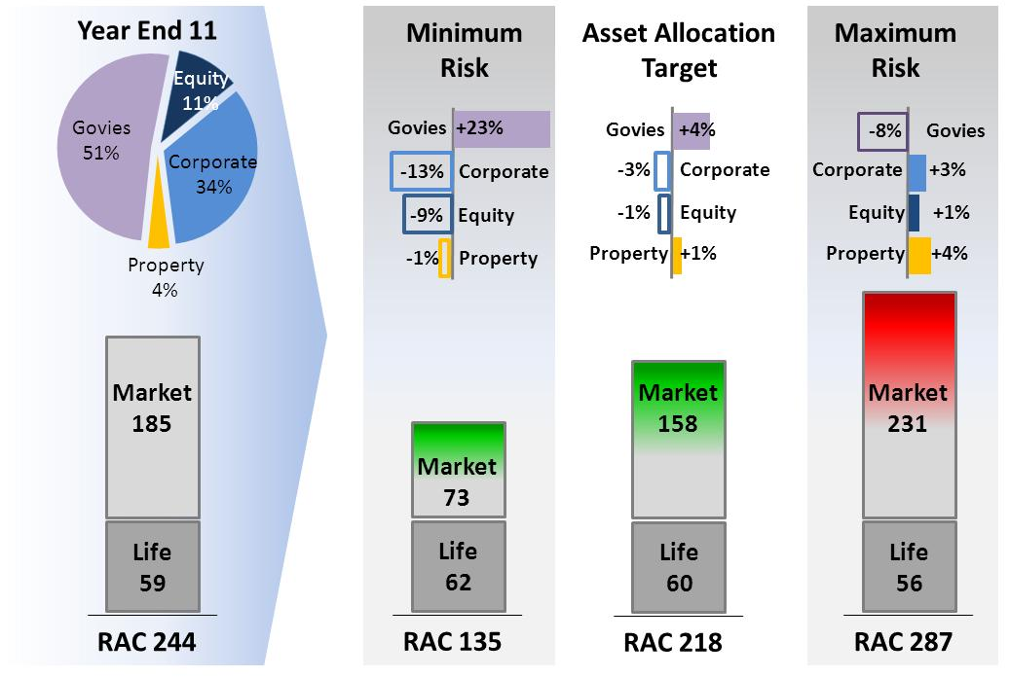
ORSA & SAA: A Segregated Fund Example
Applying Solvency II models: Risk Drivers and Practical Examples
SCR 244
SCR 135
SCR 218
SCR 287

Slide 104
AGENDA
Solvency II Framework
An Introduction to Solvency II
Solvency 2 Definitions: Available Capital and Capital Requirement
Best Estimate of Liabilities: calculation process and examples
Required Capital: calculation process and examples
Applying Solvency II models: Risk Drivers and Practical Examples
New Products and Capital Absorption: definitions and examples

Slide 105
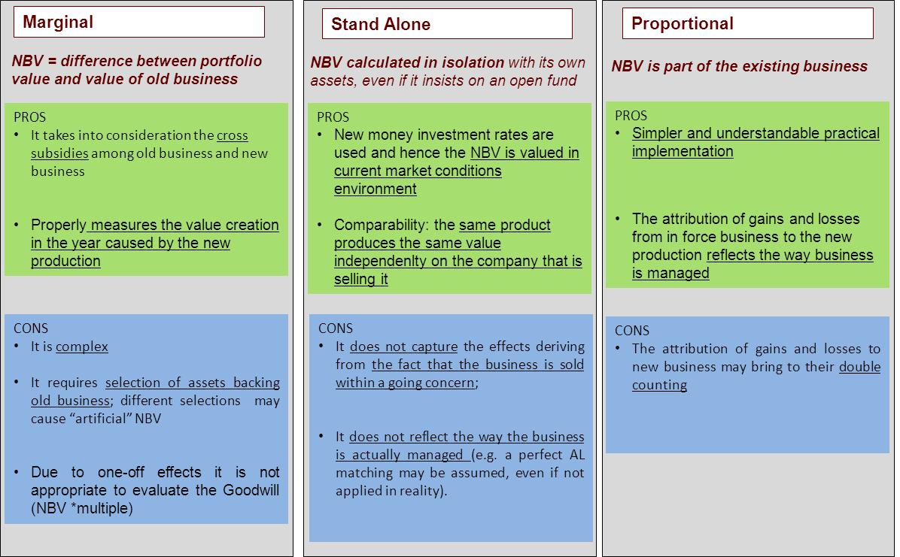
New Products and Value
Products and Capital Absorption: definitions and examples
  New Business Value = present value, at issue date, of future industrial profits (after taxes and reinsurance) expected to emerge from all contracts issued during the last

Slide 106
New Products: Profit ratios based on «volumes»
Products and Capital Absorption: definitions and examples
New Business Margin (NBM)
= NBV / APE = New Business Value/Annual Premium Equivalent (Regular premium+single premium/10)
It is a multi-period profitability indicator
Strength: widely used and easy to understand
Weaknesses: normalized assumption of 10 years of duration for single premiums
NBV/P.V. Premiums
= New Business Value/Present Value of Future Premiums
Expresses the profitability as a percentage of the products yearly turnover
Strength: solves the problem of the normalization used in the NBM, representing the effective duration of the contract
NBV/P. V. Reserves
= New Business Value/Present Value of Future Premiums
Expresses the profitability as a percentage of assets under management of the company related to the product under analysis
Strength: is a good measure of the annual profitability in terms of managed assets
Weakness: meaningless for products where the mathematical reserve is a very small amount (e.g. Pure risk products)

Slide 107
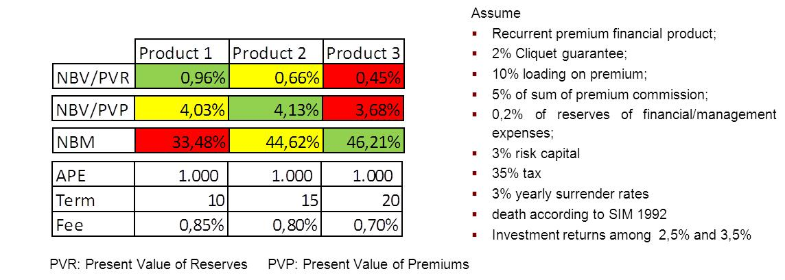
New Products: Profit ratios based on «volumes»
Products and Capital Absorption: definitions and examples
Profitability ratios based on volumes: which indicator should we look at?
NBM: the less profitable is Product 1
  the denominator is the same for the 3 products (equal to 1000) and hence increasing the term brings to higher NBV that is reported to the same amount leading to a higher value of the ratio
  the effect of the annual loss of the fee (0.15% between Products 1 and 3) is lower of the effect of gaining it for a longer time
NBV/PVP: the less profitable is Product 3
  the denominator varies i.e. increases with the term; in Product 3 the NBV (the same as in the NBM) is divided by a higher amount
NBV/PVR: the less profitable is Product 3 but the most profitable is Product 1
  this indicator rewards the product with higher management fee

Slide 108
New Products: Profit Breakdown
Products and Capital Absorption: definitions and examples
Gives indication on the equilibrium of the product among different sources of profits:
  What is the main source of profit of the product?
  Is it highly exposed on the financial side?
  Are the loadings sufficient to cover the expenses?

Slide 109
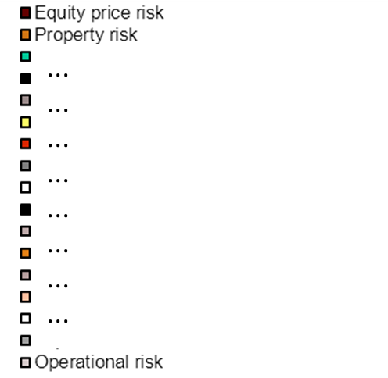
New Products: Capital Absorption
Products and Capital Absorption: definitions and examples
In a Solvency II perspective, when a new product is launched, it shall be evaluated in terms of capital absorption and remuneration
Estimate of the SCR at product level, possibly with simplified procedures that avoid fully stochastic calculations but too strong approximations (e.g. rescaling of the SCR calculated for the total new production or even worse that on the existing contracts) may be meaningless leading to totally misleading allocation of capital to the new product the company is going to launch
Solvency II is not only only quantitative time consuming and reporting but it is:
  an instrument to improve the risk management in the ‘’real world’’
  a better efficiency in the capital management

Slide 110
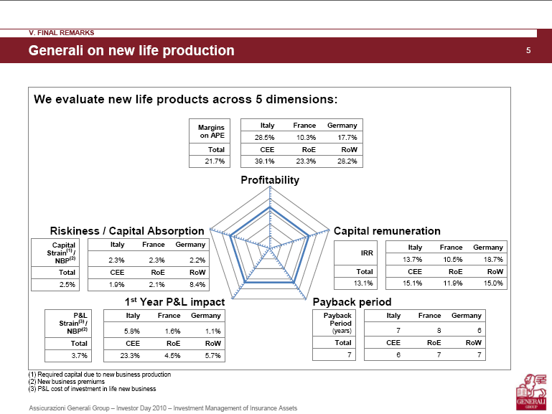
New Products: a multiple dimensions view
Products and Capital Absorption: definitions and examples

Slide 111
ORSA: New Product and Capital Absorption
Products and Capital Absorption: definitions and examples
Q: What does Free Surplus mean at product level?
A: Free Surplus = NBV - SCR
Q: When a new product is self financing?
A: When it does not require a capital injection:
  In Solvency 1: NEVER
  In Solvency 2: «could be» if the expected profits are considered as TIER 1 capital

Slide 112
ORSA: New Product and Capital Absorption
Products and Capital Absorption: definitions and examples
90/10 with profit contract , 15 yrs contractual term: Single vs Annual Premium
Single Premium
Yearly Guarantee
The product is self-financing
Technical Surplus
Max self-financing guarantee
The product has to be financed through other sources of profits

Slide 113
ORSA: New Product and Capital Absorption
Products and Capital Absorption: definitions and examples
90/10 with profit contract , 15 yrs contractual term: Single vs Annual Premium
Single Premium
Yearly Guarantee
Annual Premium
Yearly Guarantee
The product is self-financing
Technical Surplus
Technical Surplus
Max self-financing guarantee
Max self-financing guarantee
The product has to be financed through other sources of profits

Slide 114
ORSA: New Product and Capital Absorption
Products and Capital Absorption: definitions and examples
Example: 1.5% guarantee
 | Single Premium | Annual Premium
PVFP | 41 | 36
SCR | 52 | 18
FREE SURPLUS | -11 | 18
Technical Surplus
Technical Surplus
KEY POINTS
instantaneous shocks
permanent variation 1 y calibrated
instantaneous stress on asset exposures
SCR BREAKDOWN
Equity
Credit
Equity
IR
Volatility
Interest Rate
Interest Rate
Credit
IR
Volatility
Single Premium
Annual Premium

Slide 115
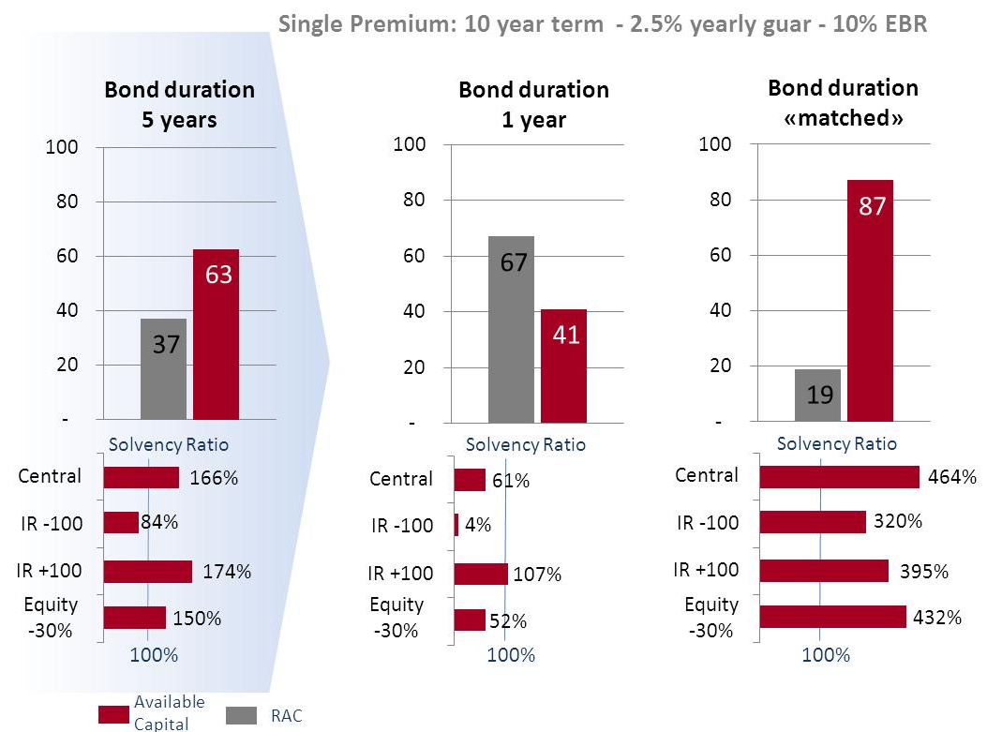
New Product and SAA: Duration GAP
Products and Capital Absorption: definitions and examples
SCR

Slide 116
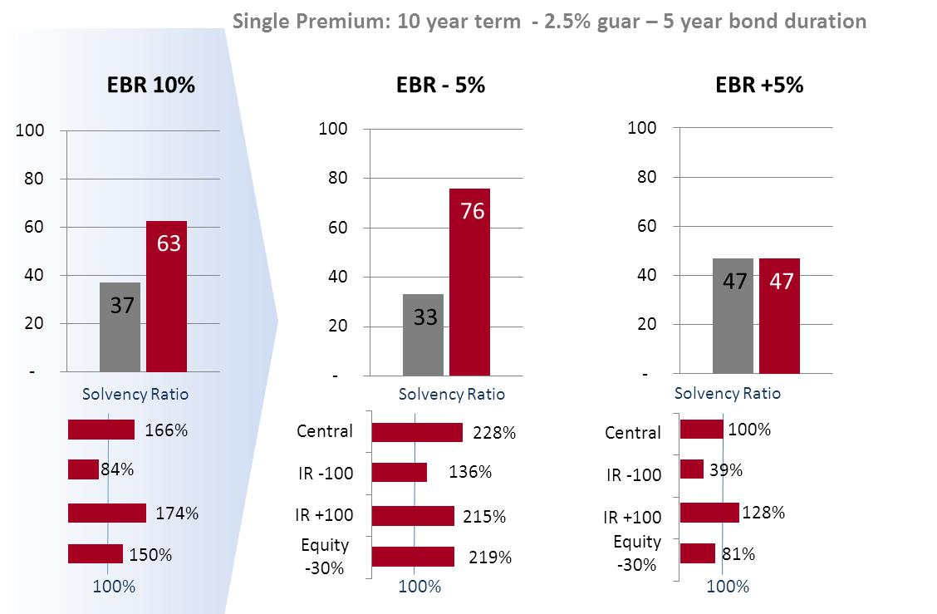
New Product and SAA: Investing in Equity
Products and Capital Absorption: definitions and examples

